Slide 1
Semester Project: Library
Amari Richardson, Bobbie Hoskins, Alex Teeter, Krystina Williamson, Shymeria Madden

Slide 2
Sprint Overview
Sprints 1-4
Sprint 1: Features 1-3
Sprint 2: Features 1-3 (Refactoring)
Sprint 3: Features 4 and 5
Sprint 4: Features 6-9
Sprint 5
Features 10 and 11

Slide 3
Sprint 1
Goal: To produce a fully functioning product increment that could take in arguments of any type, as well as display help and usage information if the “-h” argument was used.
Feature 1: Allow only string-valued positional arguments and retrieve them from the command-line.
Feature 2: Allow the inclusion of additional descriptive information on the program and each argument and provide named “-h” argument that shows usage and help information by default.
Feature 3: Allow datatype information to be added to arguments so that non-string arguments can be used.

Slide 4
Sprint 2
Goal: To refactor the code from Feature 1, as well as make Features 2 and 3 work properly.

Slide 5
Sprint 3
Goal: To produce a fully functioning product increment that could allow named and positional arguments in any order.
Feature 4: Allow named arguments with single values, which may have help and datatype information, after all positional arguments.
Feature 5: Allow named arguments to be mixed with positional arguments in any order.

Slide 6
Sprint 4
Goal: To produce a fully functioning product increment that could load throw an exception if an argument didn’t exist or was the wrong datatype, load in arguments ( whether in long or short-form) from an XML file, and recognize flags.
Feature 6: Allow named arguments to serve as flags (true if present).
Feature 7: Allow short-form names for named arguments, in addition to long-form names.
Feature 8: Throw exceptions if a specified argument does not exist or has the wrong datatype.
Feature 9: Allow argument information to be loaded from an XML file.

Slide 7
Sprint 5
Goal: To produce a fully functioning product increment that could save argument information to an XML file as well as provide documentation for the entire library.
Feature 10: Allow argument information to be saved to an XML file.
Feature 11: Provide comprehensive documentation on library features, including examples of use.

Slide 8
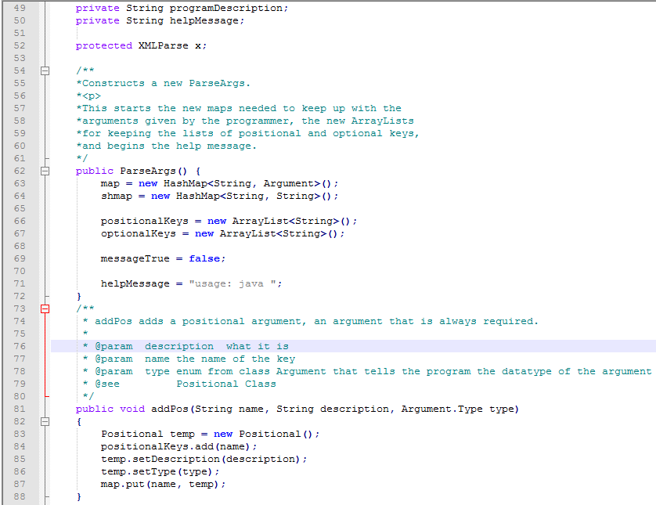
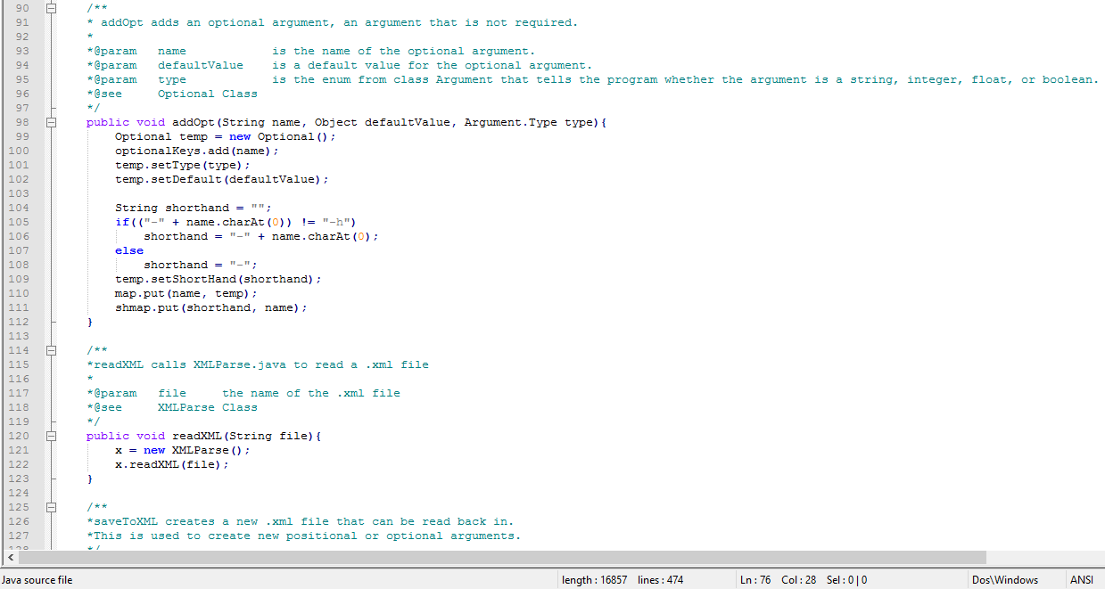
ParseArgs

Slide 9
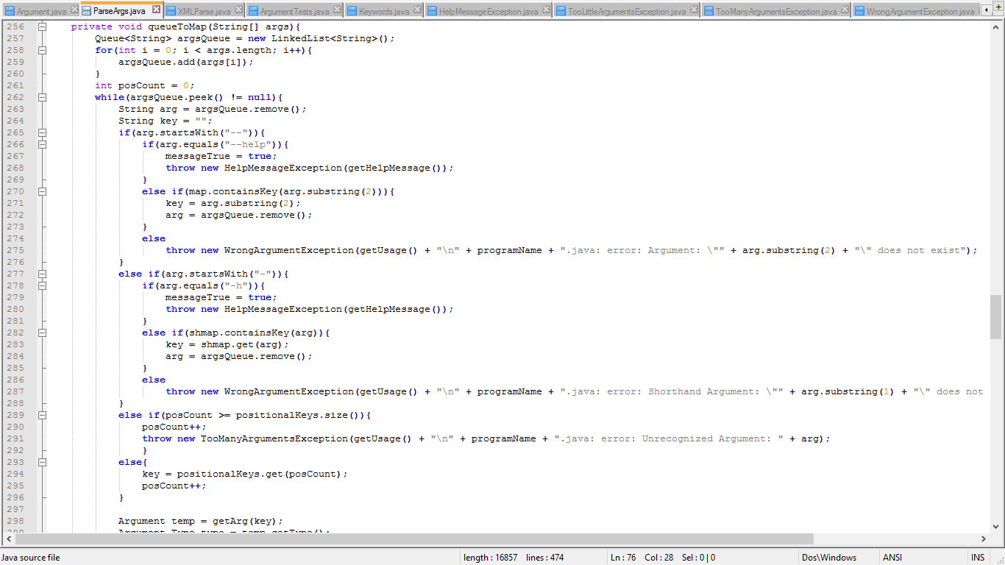
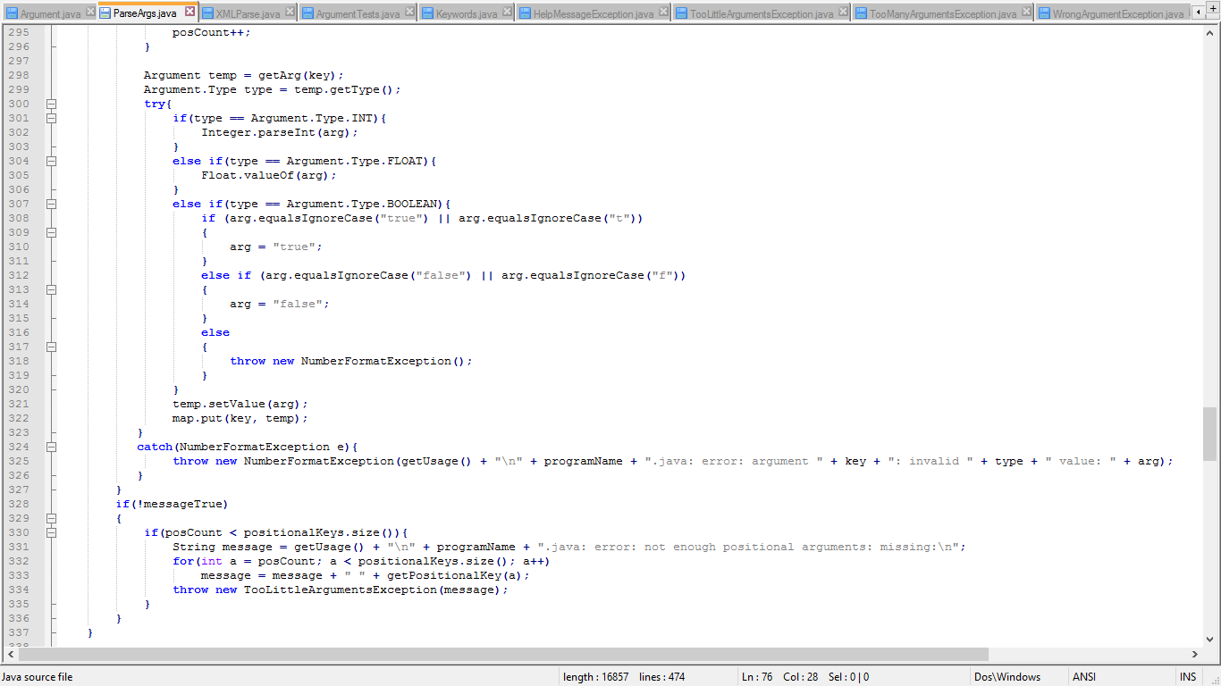
ParseArgs

Slide 10
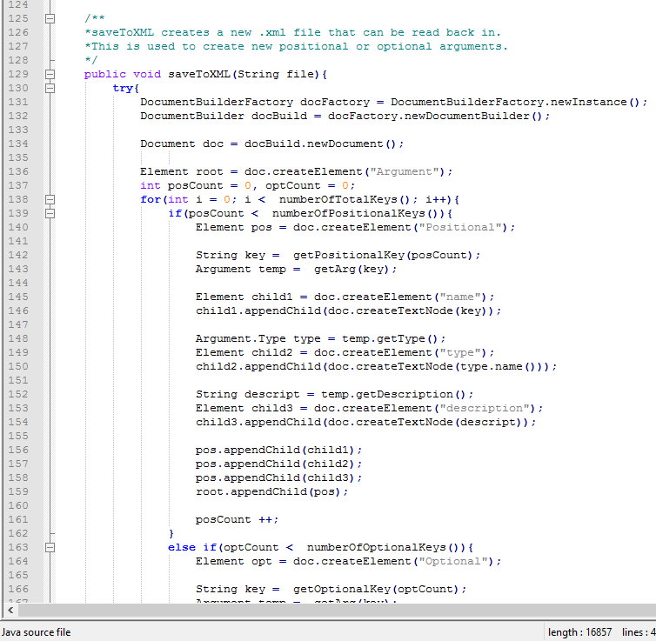
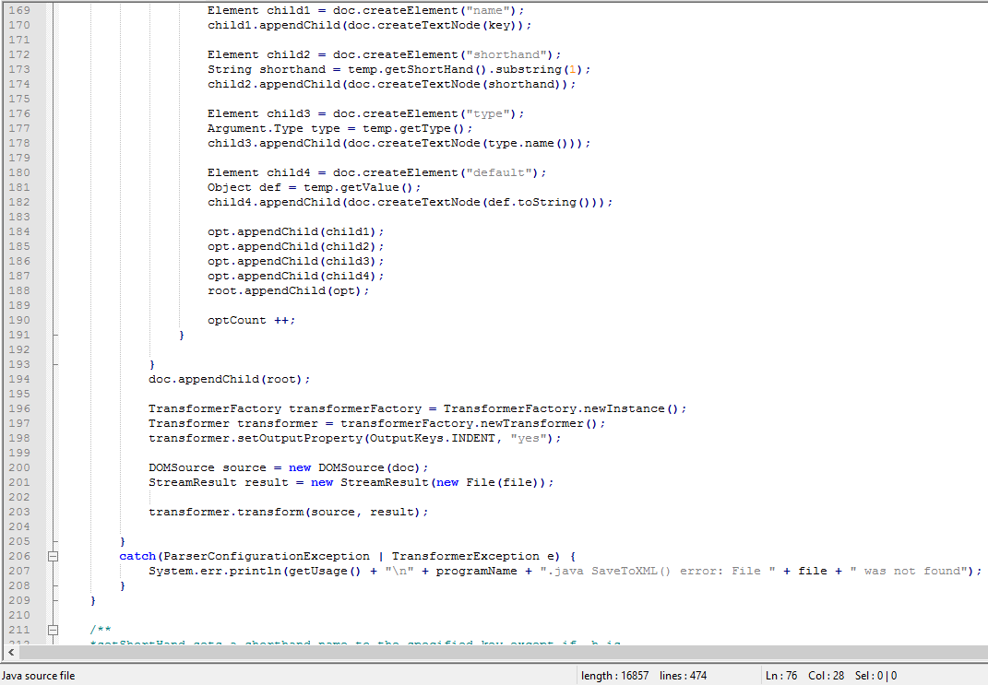
ParseArgs

Slide 11
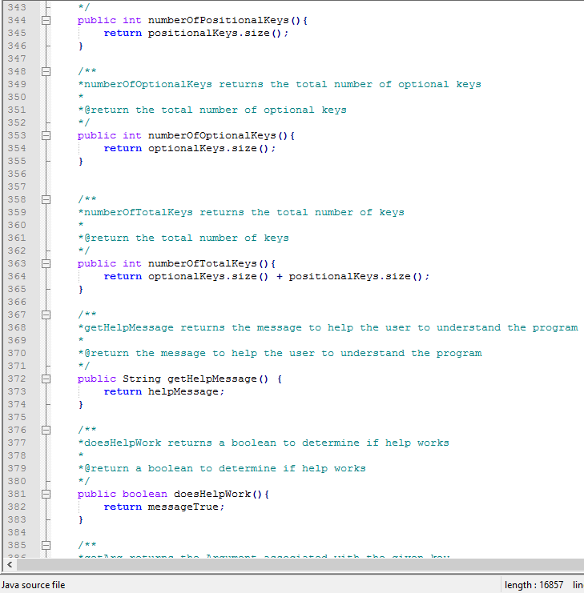
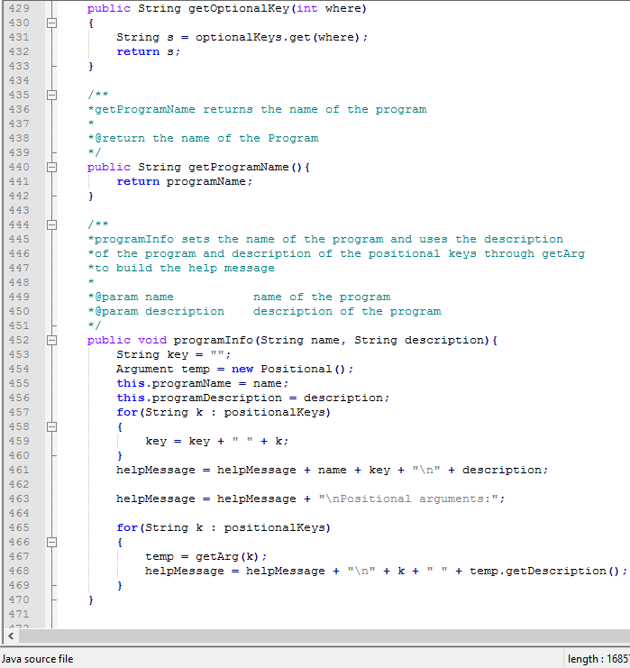
ParseArgs

Slide 12
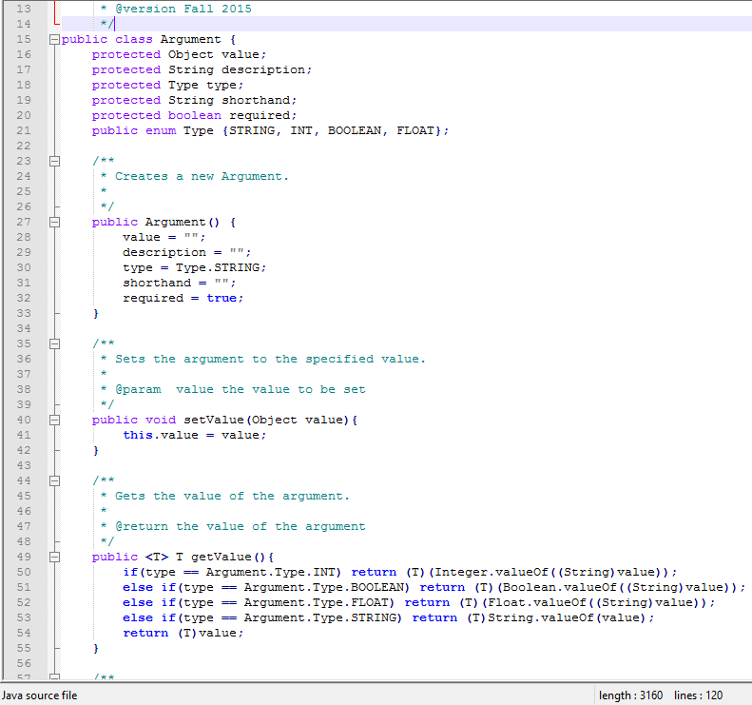
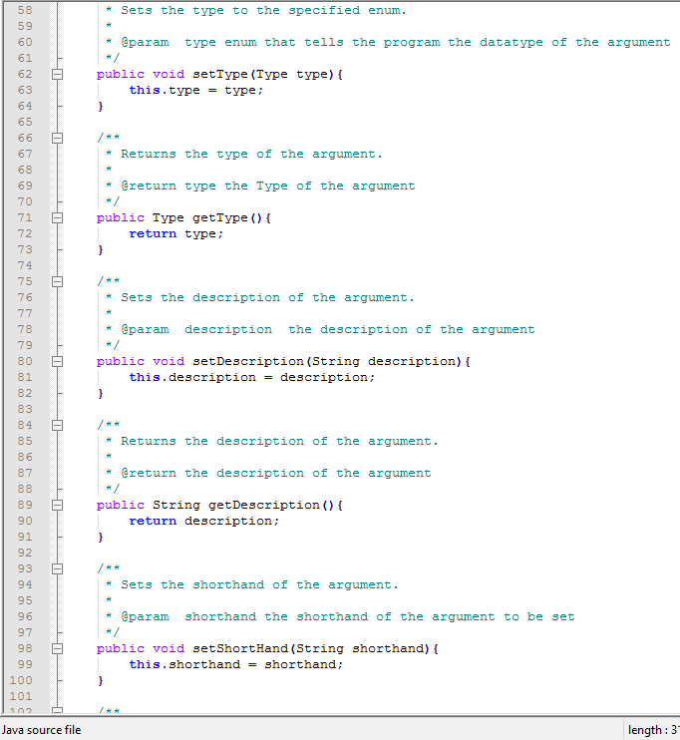
Argument

Slide 13
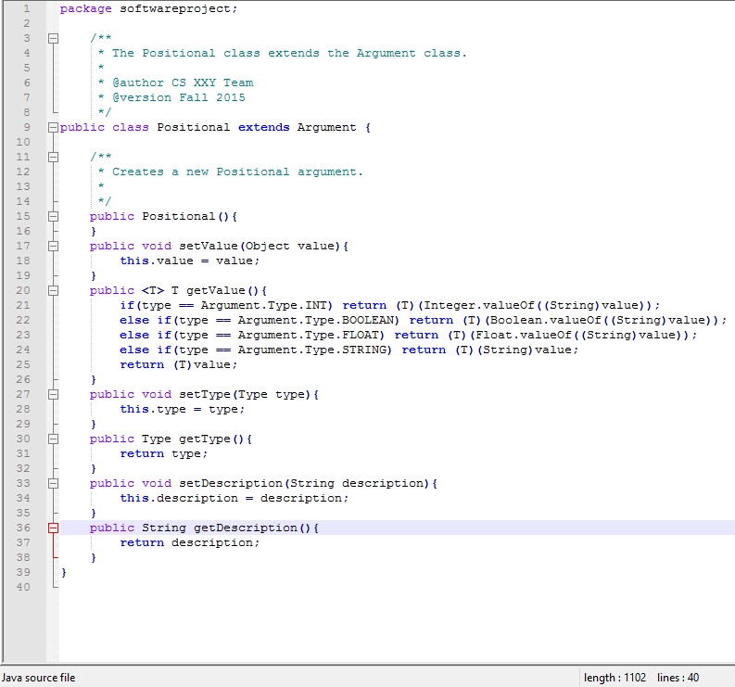
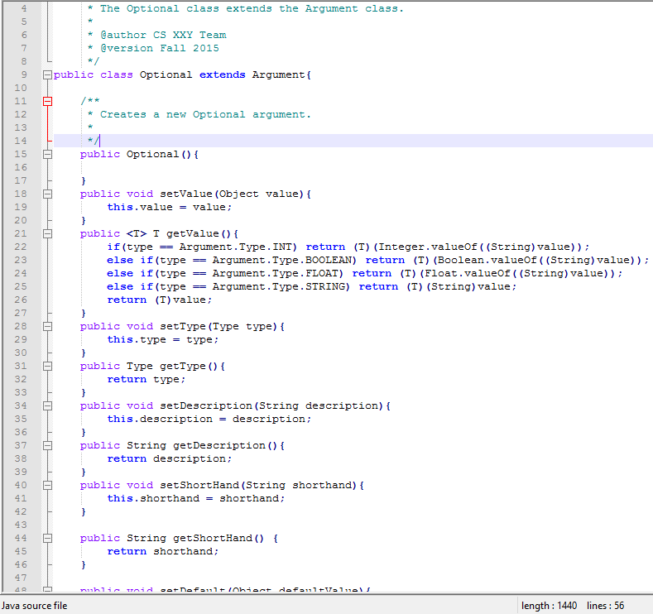
Positional And Optional

Slide 14
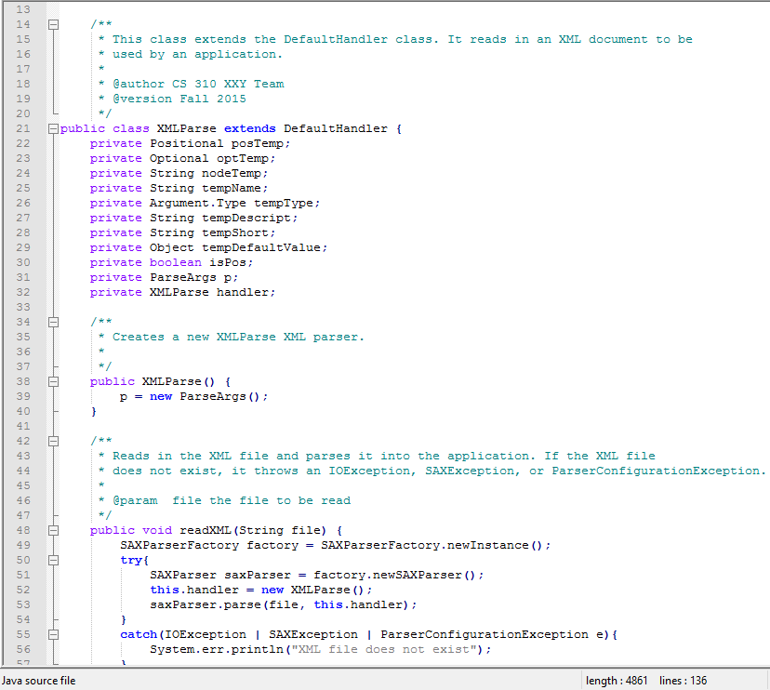
XMLParse

Slide 15
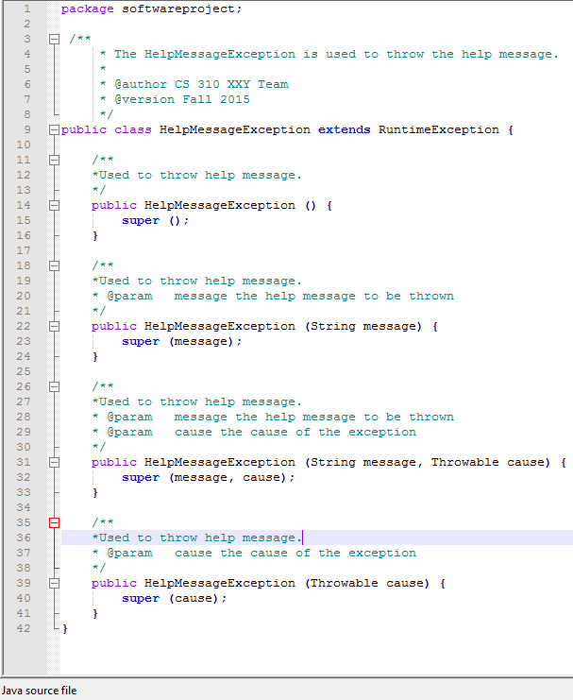
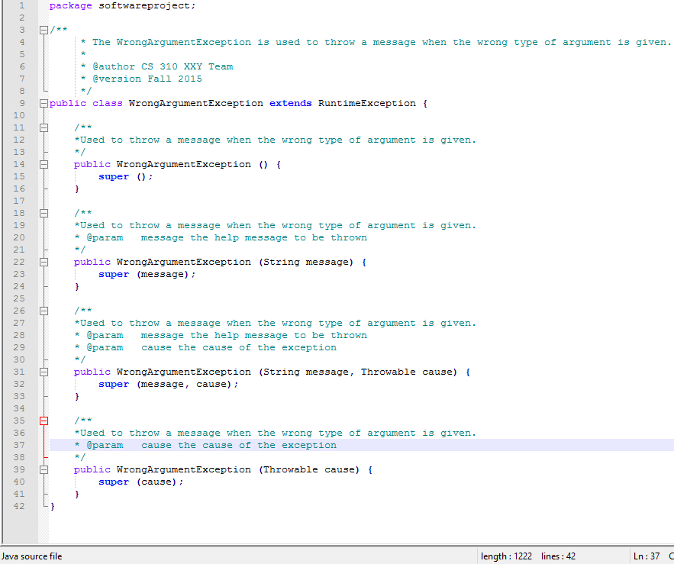
Exceptions

Slide 16
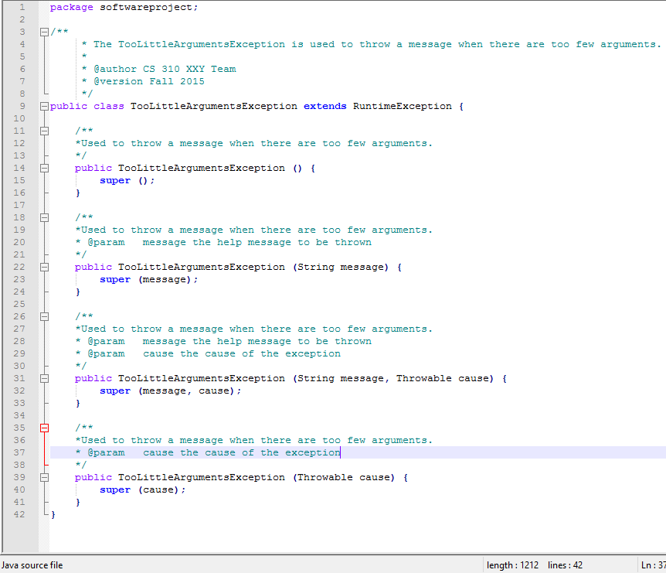
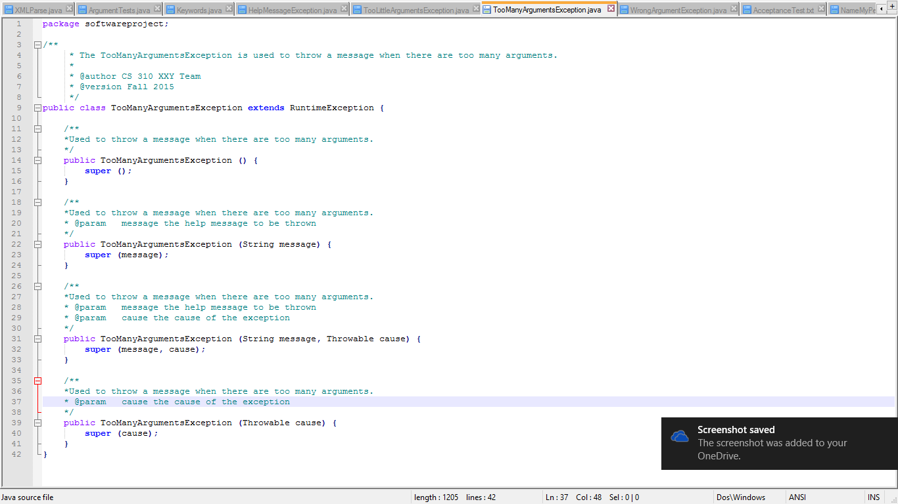
Exceptions

Slide 17
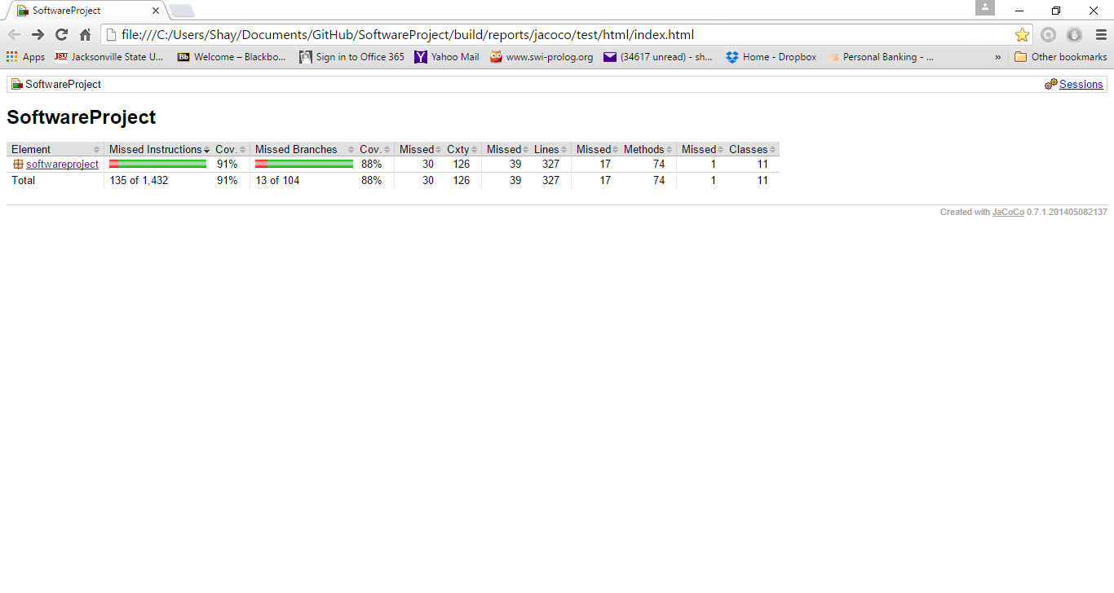
Code Coverage

Slide 18
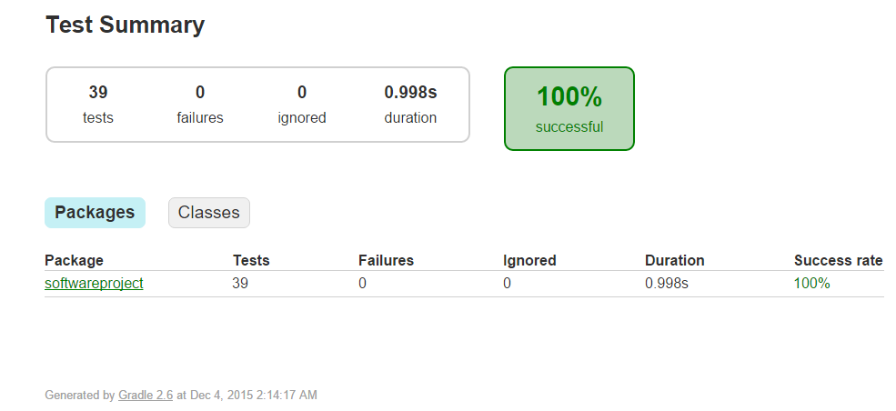
Unit Tests

Slide 19
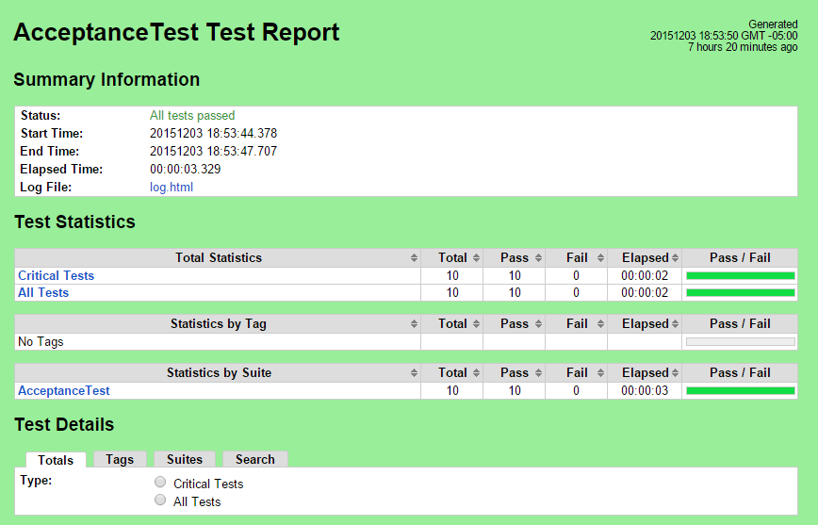
Acceptance Tests

